Slide 1



Teaching Research Skills: A Collaboration Among Peers Cross-Disciplinary Efforts to Impact and Evaluate Information Literacy
J. Sargeant Reynolds Community College, Richmond, Virginia
Beth Bensen-Barber, Assistant Professor of English
Hong Wu, Director of Library and Information Services
Denise Woetzel, Reference / Information Literacy Librarian
Ghazala Hashmi, Coordinator, Quality Enhancement Plan
New Horizons Annual Conference Roanoke, VA April 2013
Notes:
Photo: http://www.business2community.com/strategy/how-to-align-sales-and-marketing-0182866

Slide 2

Information Literacy Defined
"Information literacy is a set of abilities requiring individuals to recognize when information is needed and have the ability to locate, evaluate, and use effectively the needed information."
- Association of College & Research Libraries (ACRL)
Notes:
Photo: http://ascplcl.wordpress.com/parents-and-educators/information-literacy-resources/

Slide 3

Collaborative Overview
Aligning the Efforts of English Department Faculty & JSRCC Librarians
Notes:
Photo:http://www.geraldaungst.com/portfolio/collaboration/

Slide 4
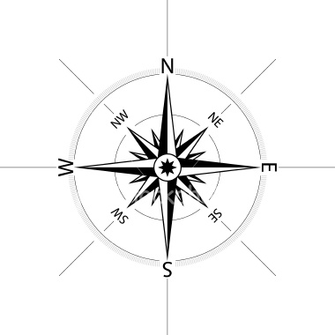
Successful alignment of information literacy across the curriculum:
Librarians
Students
Modules
Faculty
Institutional
Alignment

Slide 5
Successful alignment of information literacy across the curriculum:
Librarians
Students
Modules
Faculty
Institutional
Alignment

Slide 6
Participating ENG112 Sections Represented Varied Course Delivery Formats
9

Slide 7
All JSRCC Campuses were Represented
All JSRCC Campuses were Represented

Slide 8
Successful alignment of information literacy & Faculty Training:
Librarians
Students
Modules
Faculty
Institutional
Alignment

Slide 9
Successful alignment of information literacy & Faculty Training:
Librarians
Students
Modules
Faculty
Institutional
Alignment

Slide 10
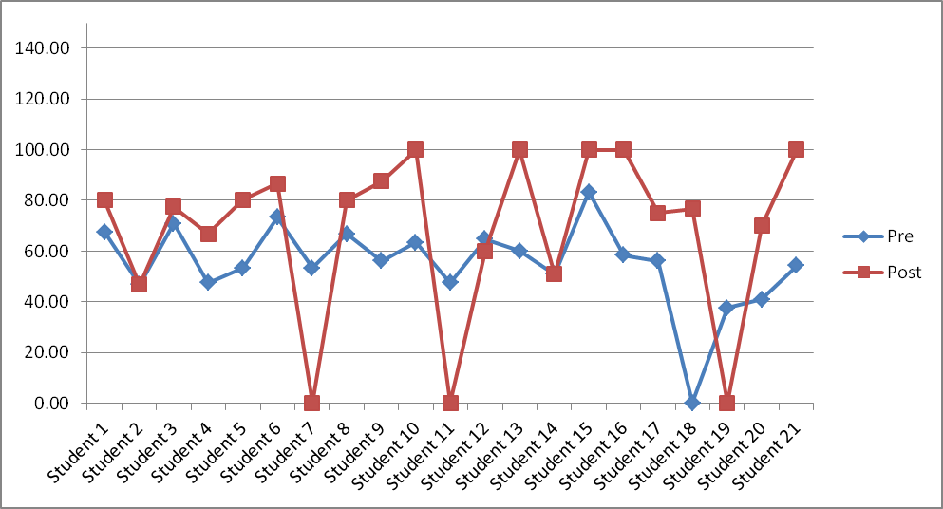
All JSRCC Campuses were Represented
Comparison Between Pre- and Post Tests (Face-to-Face, Spring 2012)

Slide 11
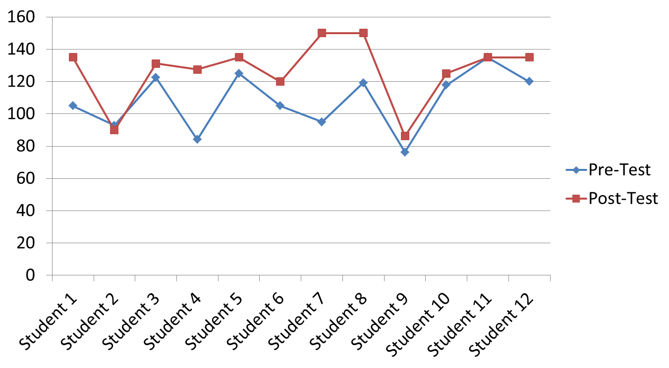
All JSRCC Campuses were Represented
Comparison Between Pre- and Post Tests ( DL, Section A, Summer 2012)

Slide 12
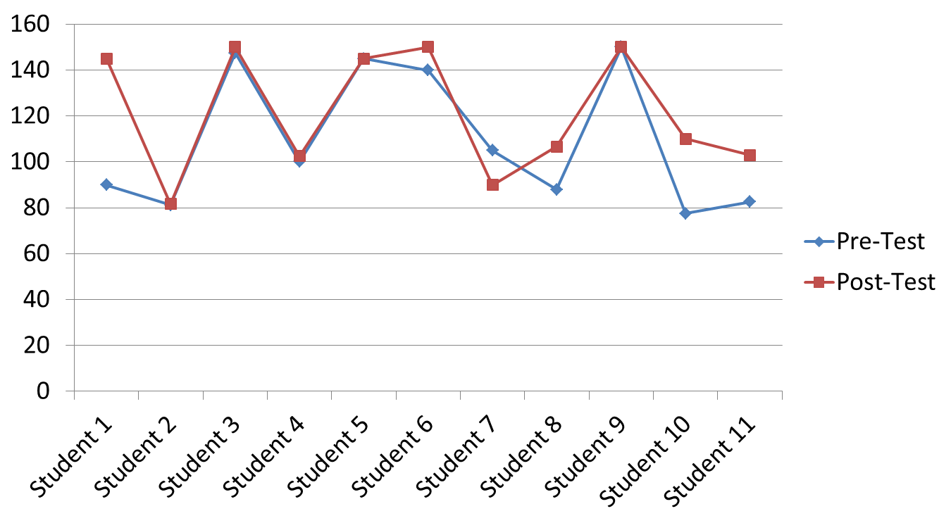
All JSRCC Campuses were Represented
Comparison Between Pre- and Post Tests ( DL, Section B, Summer 2012)

Slide 13
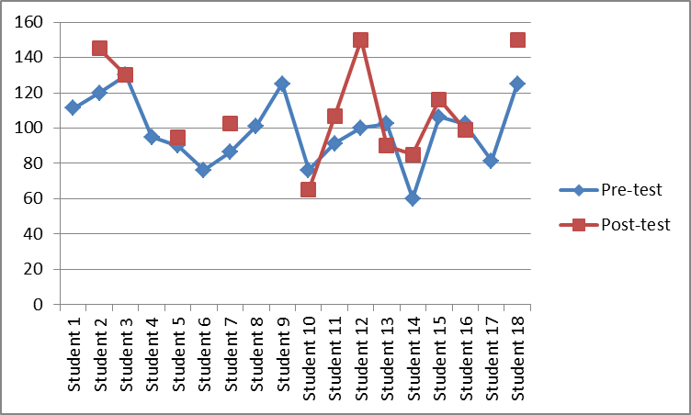
All JSRCC Campuses were Represented
Comparison Between Pre- and Post Tests ( DL, Spring 2013)

Slide 14
Successful alignment of information literacy across the curriculum: Librarians’ Perspective
Librarians
Instruction
Assessment
Faculty
Institutional
Alignment

Slide 15
Assessment Charges
Late 1990s: Governor’s Blue Ribbon Commission presents a charge
2000: State Council of Higher Education for Virginia (SCHEV) adopts the charge
2002: Virginia Community College System (VCCS) establishes a Task Force
2003: VCCS administers James Madison University’s Information Literacy test

Slide 16
Information Literacy Test Results (2003)
 | Number tested | Average Score | Median Score | Percent that met standard
VCCS | 3,678 | 36.4 | 37 | 24.40%
JSRCC | 511 | 31.18 | 31 | 16.05%

Slide 17
Dilemmas
Librarians (limited staffing)
Instruction (one shot)
Assessment
Faculty (upon request)
Institutional
Charges

Slide 18
Library’s responsive measures:
ACRLInformation Literacy Standards
F2F
Open Session Library Workshops
Customized Library Instruction
Online
Course-based LibGuides
Research at Reynolds Libraries
Assessment
Notes:
Photo: http://ascplcl.wordpress.com/parents-and-educators/information-literacy-resources/

Slide 19
Continuing Issues:
Librarians
Instruction
Assessment
Faculty
Institutional
Guidance

Slide 20
Breakthroughs
Breakthroughs
Librarians & Faculty Conversations
Information Literacy
SLOs

Slide 21

Alignment of instructional resources
Melding Library Resources within Composition Courses

Slide 22
Modules Adopted
ACRLInformation Literacy Standards
F2F
Open Session Library Workshops
Customized Library Instruction
Online
Course-based LibGuides
Research at Reynolds Libraries
Assessment
Notes:
Photo: http://ascplcl.wordpress.com/parents-and-educators/information-literacy-resources/

Slide 23
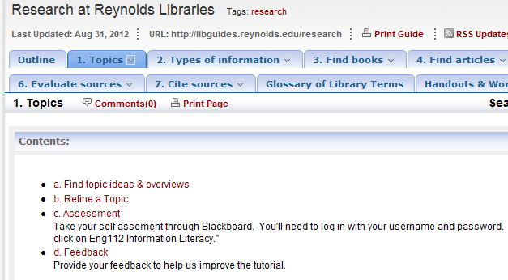
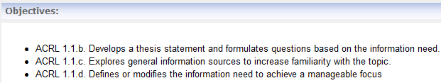
Responsive Measure 3
Research @ Reynolds Libraries Online Modules
Based on ACRL/SCHEV Competency standards
Comprehensive yet flexible
Easy to evaluate, update and revise
Available for both online/on-campus learners across the board
Easy implementation

Slide 24
Review, Review, Review & Revise
Librarians
Revise
Faculty
Students

Slide 25
Assessment Enhancement
Create
.
30 questions for pre- and post- tests
10 questions for each module
Revise
Blackboard
Review
Notes:
Images: http://1.bp.blogspot.com/-Bzgf5Ji9NRs/TbwBFwATOvI/AAAAAAAAAJw/gTBWZTxZbFg/s1600/badparagraph.jpg
http://www.bing.com/images/search?q=review&view=detail&id=E5B5854C4C8C71A359BFF9EFCE7EB087C9ED3DC4

Slide 26

Assessment
Aligning Assessment Activities with Instructional Resources, Course Objectives & Student Learning Outcomes

Slide 27
Assessing the Data Results
Assessing the Data Results
Librarians
Results of Assessment
Modules
Faculty
Institutional
Alignment

Slide 28


Measuring the Value of Information Literacy Instruction in ENG112
Both groups began the semester at comparable levels of competency in terms of their research skills: Students had basic understanding of research skills but not enough to demonstrate competency in information literacy.
Conclusion: ENG112 is an appropriate site for information literacy instruction
Control Group
Treatment Group

Slide 29
ENG112 has a significant impact upon students’ information literacy skills:

Slide 30
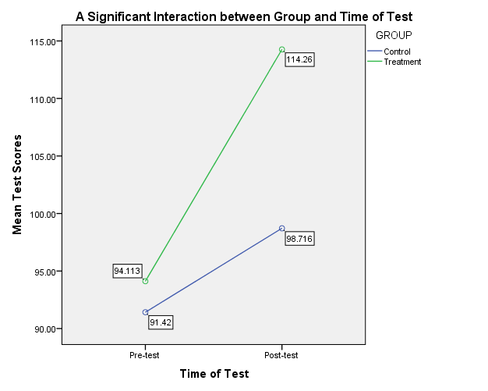
Average test results demonstrate a significant
impact upon students’ information literacy
skills:

Slide 31
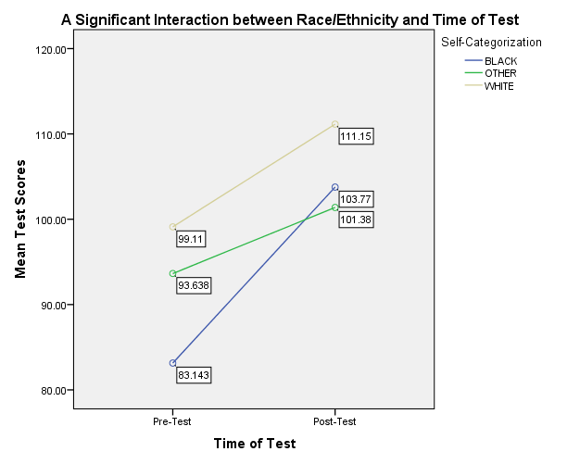
ENG112 has a significant and observable impact upon African American students’ information literacy skills:
The most significant impact was observed upon skills development of African American students.

Slide 32

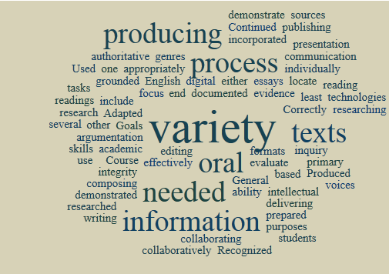

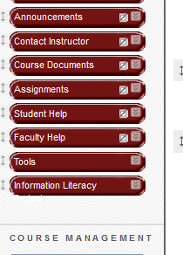
Our Good News: Alignment of Course Outcomes with Solid Instructional Resources and Effective Assessment Results in Solid Student Learning

Slide 33
Mapping new directions, using assessment results as our guide:
Librarians
Results of Assessment
Modules
Faculty
Institutional
Alignment

Slide 34
Questions ♦ Comments
For presentation handouts, please visit
http://libguides.reynolds.edu/vag2012
Notes:
Photo:http://www.geraldaungst.com/portfolio/collaboration/

